Slide 1
Electrolytes and Fluid Balance

Slide 3
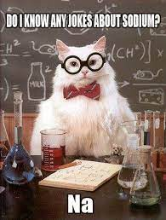
Sodium: 135 –145 mEq/L
The electrolyte sodium supports the function of nerves and muscles, helps maintain a normal blood pressure, and regulates the body’s fluid balance.
Needed for nerve impulses
Low sodium levels are called hyponatremia.
High sodium levels are called hypernatremia.

Slide 4
Hypernatremia – greater than 145 mEq/L
Causes:
Gastroenteritis
Vomiting
Prolonged suction
Burns
Excessive sweating
Chronic kidney disease
Diabetes
Impaired thirst response
  Or inability to communicate thirst
Signs & symptoms:
Confusion
Lethargy
Irritability
Thirst
Decreased urine
Level of consciousness changes
Notes:
Cause: Diabetes Insipidus, insensible perspiration, water deprivation, hypertonic fluids
S&S- Decreased LOC, thirst, seizures
Tx- Oral water, hypotonic IV fluids
CNS symptoms because brain cells shrivel (hypernatremia
Hypernatremia is most commonly seen when the body water loss is greater than the solute loss. However, it can also be a result of too much sodium, or a combination of the two.
Reasoning: Less water relative to sodium → cells shrink, brain issues, etc.

Slide 5
Hypernatremia – Treatment and Nursing Care
Treatment:
  Identify the underlying cause first
  Mild hypernatremia: encourage oral fluids
  Moderate to severe: IV fluids
  Decrease sodium level SLOWLY — rapid correction causes cerebral edema
  Treat underlying cause (diarrhea, vomiting, polyuria)
Nursing considerations:
  Monitor neurological status — confusion and LOC changes are key indicators
  Strict intake and output
  Daily weights
  Monitor serum sodium levels closely during correction
  Assess skin turgor and mucous membranes for dehydration
  Fall precautions
  Patient education: limit high-sodium foods, read food labels, adequate fluid intake

Slide 6
Hyponatremia – less than 135 mEq/L
Causes:
Chronic/severe vomiting or diarrhea
Excessive water intake
Heart, kidney, liver conditions
  Heart failure or cirrhosis
    Leads to fluid retention and dilution of sodium
Medications
  Diuretics
Signs & symptoms:
Nausea
Lethargy
Confusion
Headache
Restlessness
Notes:
Water excess
Cause: SIADH, water intoxication, tap water enemas, hypotonic fluids
S&S- Decreased LOC, seizures
Tx- fluid restrictions
CNS symptoms because brain cells shrivel (hypernatremia) or brain cells swell (hyponatremia)
Treatment: Fluid restrictions, hypertonic solutions, antidiarrheals, antiemetics
Reasoning: When there’s more free water relative to sodium, the concentration falls; or sodium is lost and water remains → cell swelling, neurological effects.
“If sodium is like the salt in the soup (extracellular fluid), when you dilute the soup too much (free water excess) you get hyponatremia”

Slide 7
Hyponatremia – Treatment and Nursing Care
Treatment:
  Identify the underlying cause
  Fluid restriction — most common first-line treatment
    Avoid gum, candies, and other hidden fluid sources
    Develop plan with client
  IV fluids to restore sodium
  Antiemetics and antidiarrheals if GI losses are the cause
  Treatment varies by underlying disease process
Nursing considerations:
  Monitor neurological status continuously — seizure risk with severe hyponatremia
  Strict intake and output and fluid restriction education
  Daily weights
  Monitor all fluid sources — IV fluids, medications, oral intake
  Educate patient on fluid restriction — why it matters and what counts as fluid
Notes:
Fluid restriction is the intervention that may seem counterintuitive — a patient who seems unwell is being told to drink less, not more. The explanation is that in dilutional hyponatremia the problem is too much water diluting the sodium, not too little sodium. Education on what counts as fluid — ice chips, gelatin, soup, ice cream — is essential and frequently missed.

Slide 8
A client with chronic heart failure presents with confusion, nausea, and a sodium level of 128 mEq/L. Which cause most likely explains this finding?
A. Excessive sweating
B. Fluid retention
C. Inadequate dietary intake of salt
D. Renal potassium wasting

Slide 9
A client with sodium of 150 mEq/L is treated with IV fluids. Which principle is most important?
A. Decrease sodium level rapidly
B. Increase dietary sodium
C. Decrease sodium level slowly
D. Administer diuretics immediately

Slide 10
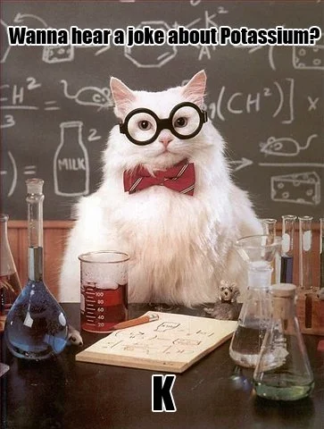
Potassium: 3.5 - 5 mEq/L
The electrolyte potassium helps with nerve and muscle cell function while playing an important role in the muscle cells in the heart.
Needed for nerve conduction and muscle function (skeletal, smooth, cardiac)
Controls rate and force of heart contraction
Kidneys responsible for primary excretion
Low potassium levels are called hypokalemia.
High potassium levels are known as hyperkalemia.

Slide 11
Hyperkalemia – greater than 5 mEq/L
Causes:
Renal failure
Dehydration
Medications
  Potassium sparing diuretic
  NSAIDs
Excessive K+ intake
Sepsis
Intestinal obstruction
Signs & symptoms:
Mild high may be asymptomatic
Muscle weakness
Fatigue
Chest pain
Cardiac dysrhythmias
Heart failure
Cardiac arrest
Peaked T waves
Notes:
Most dangerous imbalance!!!
Causes: Potassium-sparing diuretics, Renal failure, Intestinal obstruction, Excessive intake of K+, Acidosis
S&S: Apathy, Muscle weakness, Diarrhea, cardiac dysrhythmias, peaked T waves, cardiac arrest
RN Interventions:
Monitor VS
Heart monitor
Decrease potassium intake
Diuretics, dialysis, Kayexalate, regular insulin
How is potassium excreted?--- urine and feces
Kayexalate is a laxative that can be given PO or by enema- it swaps sodium for potassium so the patient will excrete more potassium from the stool.
Regular insulin will be given IV- it will shift the K+ from the blood into the cells. Will probably have to give dextrose to counter low blood sugars.
How do we check renal function?---- creatinine! Normal is 0.6-1.2

Slide 12
Hyperkalemia – Treatment and Nursing Care
Treatment:
  Identify the cause
  Goal: remove potassium and stabilize the heart
    Place on continuous cardiac monitor immediately
    Calcium gluconate IV — stabilizes cardiac membrane (does not lower K+)
  IV insulin: drives K+ into cells temporarily
  Loop or thiazide diuretics
    promote renal excretion
    ONLY if not in renal failure
  Kayexalate
  Dialysis if renal failure or severe and unresponsive to treatment
Nursing considerations:
  Continuous cardiac monitoring
  Hold potassium-containing medications and IV fluids
  Dietary restriction: avoid bananas, oranges, potatoes, tomatoes, salt substitutes
  Monitor blood glucose after insulin administration
  Monitor urine output — adequate kidney function is essential for excretion
  Assess neuromuscular status — weakness and paralysis can progress rapidly
  Educate on low-potassium diet and avoiding potassium-based salt substitutes
Notes:
. Calcium gluconate is given first not because it lowers potassium but because it protects the heart while other treatments take effect — it raises the threshold for cardiac cell depolarization, buying time. Insulin drives potassium into cells temporarily — it is a bridge, not a cure. Kayexalate and diuretics actually remove potassium from the body. Dialysis is the definitive treatment when the kidneys cannot excrete potassium. The blood glucose monitoring after insulin is a patient safety imperative — hypoglycemia can occur rapidly and the dextrose given with the insulin may not be sufficient. Salt substitutes are a frequently missed dietary source of potassium — patients who are told to reduce sodium often switch to salt substitutes without knowing they are potassium chloride.

Slide 13
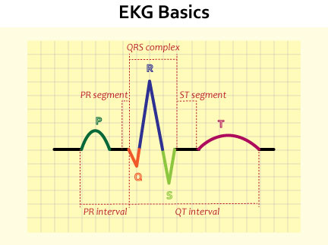

Slide 14
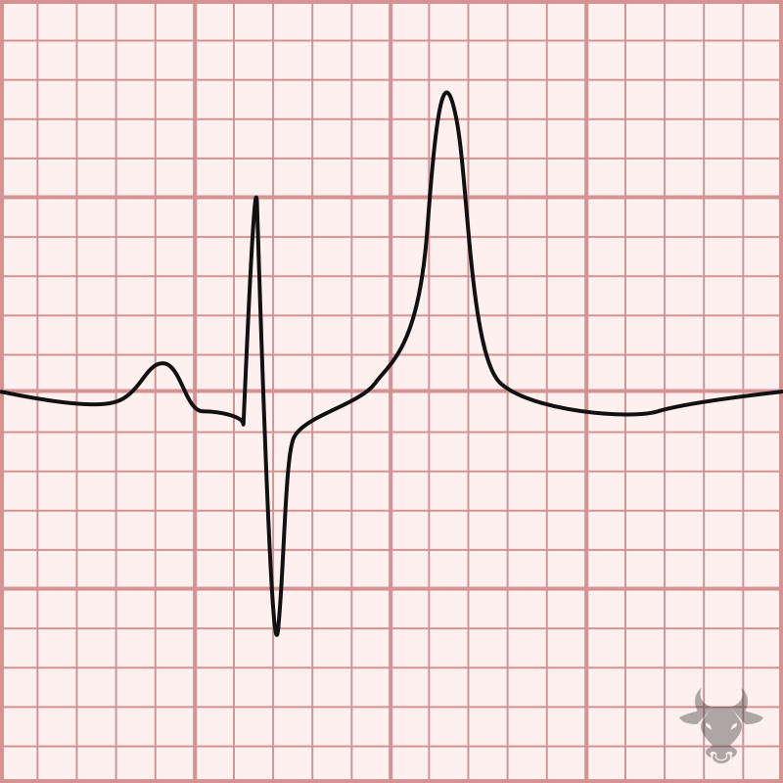
Hyperkalemia EKG

Slide 15
Hypokalemia – less than 3.5 mEq/L
Causes:
Medications
  Diuretics: loop, thiazide, osmotic
GI losses
Decrease in K+ intake
Excessive alcohol
Chronic kidney
Excessive gastric suctioning
Signs & symptoms:
May not have any with mild low levels
Muscle weakness
Cardiac arrhythmias
Fatigue
Respiratory paralysis
Confusion
Decreased/absent reflexes
Inverted T wave on EKG
Notes:
seHypokalemia may also impair the ability of the kidneys to concentrate urine, resulting in excessive urination (polyuria) and excessive thirst (polydipsia)
Causes: Non-potassium sparing diuretics, Diarrhea/Vomiting, Inadequate intake of K+, Alkalosis
S&S- Muscle weakness (respiratory muscles),leg cramps, Shallow respirations and thready pulse, Confusion, Decreased or absent reflexes, constipation, flat/inverted T waves
RN Interventions:
Monitor VS
Heart Monitor
Increase potassium intake
Check renal function before giving potassium chloride!
PO potassium supplements
IV- NO PUSH!!!! MUST BE DILUTED!!!!
IV- no more than 20 mEq/hr

Slide 16
Hypokalemia – Treatment and Nursing Care
Treatment:
  Identify the cause
  Place on continuous cardiac monitor
  Increase oral potassium intake: bananas, baked potato, nonfat yogurt, salmon, spinach
  Oral potassium supplements (KCl) for mild to moderate deficiency
  Change diuretic if medication-induced (loop to potassium-sparing)
  IV potassium for critically low levels — with strict safety rules:
  NEVER give IV potassium as a push
  MUST be diluted — no more than 10 mEq per 100mL
  Maximum 20 mEq/hr via peripheral IV
Nursing considerations:
  Continuous cardiac monitoring
  Assess muscle strength and respiratory effort — severe hypokalemia causes respiratory paralysis
  Assess deep tendon reflexes — decreased or absent reflexes indicate severe deficiency
  IV potassium burns — assess IV site frequently during infusion, use large vein
  Never give IV potassium via IV push under any circumstances
  Monitor magnesium — hypomagnesemia makes hypokalemia difficult to correct
  Educate on potassium-rich foods and medication compliance
Notes:
IV potassium safety is one of the highest-stakes nursing responsibilities in electrolyte management and deserves emphasis. Potassium chloride is a high-alert medication — it appears on the Institute for Safe Medication Practices (ISMP) list of medications that have caused patient death when misused. IV potassium administered as a push or at too high a concentration causes immediate cardiac arrest. Many facilities have removed concentrated potassium from floor stock entirely and require pharmacy preparation of all potassium infusions for exactly this reason. The pain at the IV site is a real clinical issue — potassium is caustic to veins and patients frequently complain of burning during infusion. Slowing the rate slightly and ensuring adequate dilution helps, but pain is expected and should be communicated to the patient in advance. The relationship between potassium and magnesium is clinically important: hypokalemia is very difficult to correct when hypomagnesemia is present simultaneously because magnesium is needed for the cellular mechanism that maintains potassium balance. Always check magnesium when treating hypokalemia.

Slide 17
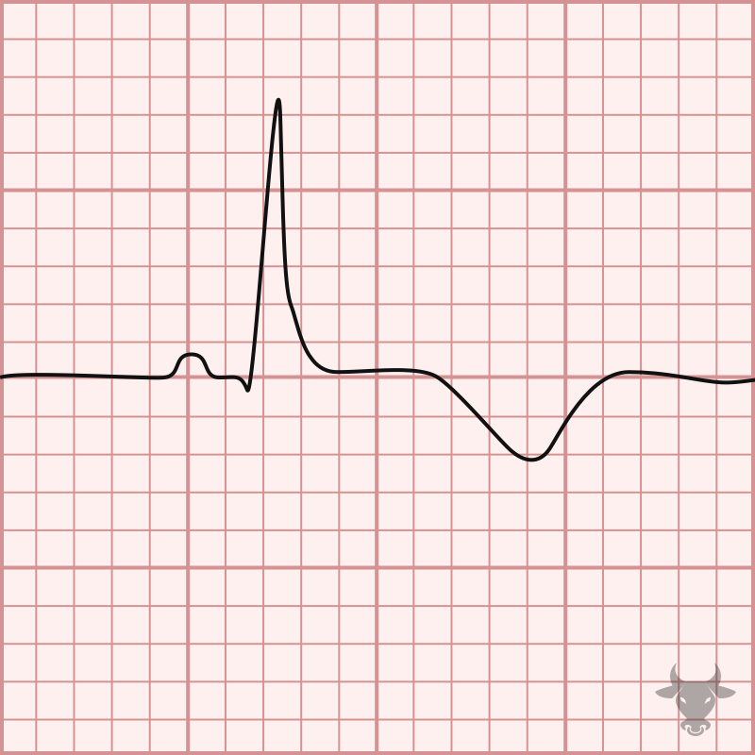
Hypokalemia EKG

Slide 18
A client has K⁺ of 6.1 mEq/L. Which provider order should the nurse complete first?
A. Administer oral potassium
B. Place the client on a cardiac monitor
C. Start potassium-sparing diuretic
D. Encourage high-potassium foods

Slide 19
A client on furosemide (Lasix) develops K⁺ of 3.0 mEq/L. Which intervention is appropriate?
A. Give IV potassium as a bolus push
B. Discontinue all fluids
C. Administer oral potassium supplements
D. Restrict potassium-rich foods

Slide 20
Calcium: 8.4 – 10.5 mg/dL
Calcium helps the body maintain strong bones and is mostly stored in teeth and bones to support their hardness.
Calcium also helps muscles move, nerves to carry messages between the brain and body, and blood vessels to move blood throughout the body.
Low calcium levels are called hypocalcemia.
High calcium levels are called hypercalcemia.
Notes:
Hypoparathyroidism, low parathyroid hormone levels, is a common cause of low calcium levels.
Hypercalcemia is most commonly caused by overactive parathyroid glands, or hyperparathyroidism.

Slide 21
Hypercalcemia – greater than 10.5 mg/dL
Causes:
Renal failure
Cancer
Hyperparathyroidism
Vitamin D toxicity
Prolonged bed rest
  Quickly reversed with movement
Signs & symptoms:
Mild rarely has symptoms
GI symptoms usually first
  Nausea
  Abdominal pain
  vomiting
Confusion
Thirst
Bone pain
Muscle weakness
Notes:
The most common causes of hypercalcemia are hyperparathyroidism and cancer. Both of these conditions result in excessive calcium being drawn from the bones and into the bloodstream. In hyperparathyroidism, the parathyroid glands secrete excessive amount of the hormone PTH. The elevated PTH levels in the body then lead to increased absorption of calcium by the intestines, increased reabsorption by the kidneys, and increased bone resorption—a process that ultimately leads to excessive levels of calcium in the blood.
Causes: Excessive Ca+/Vit D intake, bone tumors, fractures, hyperparathyroidism
S&S: Pathological fractures, Decreases neuromuscular excitability, ↑HR/BP, bounding pulse, late bradycardia, confusion, lethargy
RN Interventions:
Monitor VS
Cardiac monitor
Restrict Ca+ intake
Increase mobility
Loop diuretic, isotonic IV fluids

Slide 22
Hypercalcemia – Treatment and Nursing Care
Treatment:
  Identify underlying cause
  Mild: oral phosphate to block calcium absorption
  Moderate to severe: IV normal saline bolus — promotes renal excretion
  Loop diuretics (furosemide) following hydration — increase calcium excretion
  Calcitonin — rapid but short-acting reduction in calcium
  Dialysis for severe cases or renal failure
  Encourage ambulation — movement promotes calcium return to bone
Nursing considerations:
  Encourage ambulation and weight-bearing activity when safe — immobility worsens hypercalcemia
  Increase fluid intake — dilutes calcium and promotes excretion
  Fall precautions — muscle weakness and confusion increase fall risk
  Assess for bone pain — especially in cancer patients where bone metastasis may be the cause
  Seizure precautions in severe cases
  Low-calcium diet education: limit dairy, calcium-fortified foods
Notes:
The mnemonic for hypercalcemia symptoms is Bones, Groans, Moans, and Psychic Overtones — bone pain, GI symptoms (nausea, constipation, abdominal pain), muscle weakness, and neurological/psychiatric symptoms (confusion, depression, lethargy). Hypercalcemia of malignancy is one of the most common metabolic emergencies in cancer patients — it occurs when tumors either produce PTH-related peptide that mobilizes calcium from bone, or when bone metastases directly destroy bone and release calcium into the bloodstream. The nurse who sees a cancer patient with new confusion, nausea, and constipation should have hypercalcemia on their differential. Immobility is both a cause and a complication — bedbound patients continuously lose calcium from bone into the bloodstream, which is why encouraging ambulation is a direct treatment intervention and not just general care.

Slide 23
Hypocalcemia – less than 8.4 mg/dL
Causes:
Medications
Inadequate vitamin D
Hormonal changes
Hypoparathyroidism
Renal disease
Signs & symptoms:
Numbness and tingling or fingers, toes, and around mouth
Muscle cramping and spasms
Confusion
Lethargy
Seizures
Tetany
Chest pain
Dysrhythmias
Notes:
Causes: inadequate Ca+/Vit D intake, diarrhea, hypoparathyroidism, renal disease
Hypoparathyroidism - Body produces low levels of parathyroid hormone (PTH). The parathyroid glands, which are located in the neck behind the thyroid gland, are responsible for the secretion of PTH. The function of PTH is to maintain the proper amount of calcium in the body. Among the various causes of decreased PTH in the body, the most common are thyroid or neck surgery. Decreased PTH may lead to the need for lifetime supplementation of calcium.
S&S: Increases neuromuscular excitability, ↑ HR, ↓BP, tetany, tingling, twitching, + Chvostek’s and Trousseau’s sign
RN Interventions:
Monitor VS
Check for Chvostek’s/Trousseau’s signs
Initiate seizure precautions
Increase Ca+ intake
Calcium/Vit D supplements
3 T’s are tetany, tingling, and twitching

Slide 24
Hypocalcemia – Treatment and Nursing Care
Treatment:
  Identify underlying cause
  Mild: oral calcium supplements and vitamin D
  Dietary sources: dairy, almond milk, fortified OJ, leafy greens
  Moderate to severe: IV calcium gluconate — slow IV push or infusion
  Correct hypomagnesemia concurrently — magnesium needed for PTH function
  Seizure precautions for symptomatic patients
  Long-term management: vitamin D and calcium supplementation, dietary modification
Nursing considerations:
  Assess for Chvostek's sign: tap facial nerve — positive if facial twitching occurs
  Assess for Trousseau's sign: inflate BP cuff above systolic for 3 min — positive if carpal spasm occurs
  Seizure precautions: padded side rails, suction and oxygen at bedside
  Monitor deep tendon reflexes — hyperreflexia indicates worsening
  Educate on dietary calcium and vitamin D sources
  Long-term: monitor bone density — chronic hypocalcemia causes osteopenia and osteoporosis
Notes:
. The nurse who recognizes stridor or respiratory distress in a hypocalcemic patient must treat this as an airway emergency. This is why calcium gluconate must be readily available at the bedside of any patient with severely low calcium. Chvostek's and Trousseau's signs are classic physical examination findings that confirm neuromuscular irritability from hypocalcemia. Trousseau's is considered more sensitive and specific than Chvostek's. A positive Trousseau's sign — carpal spasm when the blood pressure cuff is inflated — is a reliable indicator that the patient has significant hypocalcemia even when symptoms are otherwise absent.

Slide 25
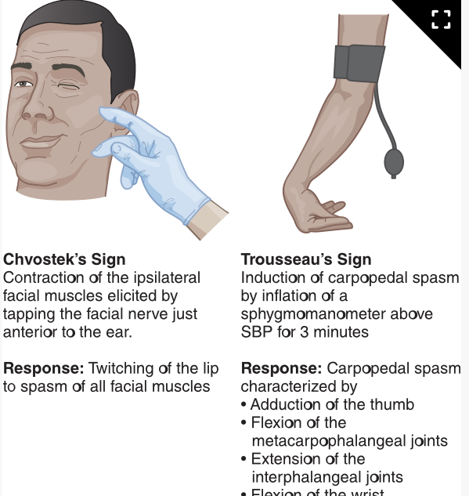
Chvostek’s and
Trousseau’s

Slide 26
Hypocalcemia
Over time, the body takes calcium from bone, where it is stored, so as to maintain sufficient calcium levels in the blood.
Hypocalcemia can lead to osteopenia, also known as low bone mass, and increase the risk of bone fractures and osteoporosis.

Slide 27
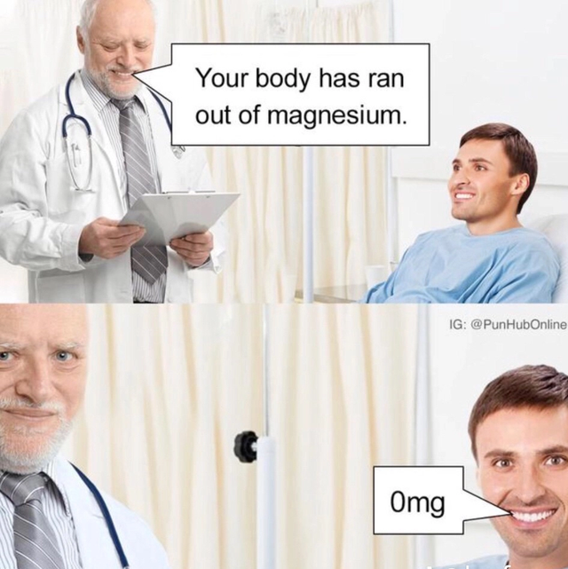
Magnesium: 1.5 – 2/5 mg/dL
Magnesium’s role in the body is to assist in the regulation of nerve and muscle function, blood pressure and blood sugar levels; as well as making bone, protein, and DNA.
Low magnesium levels are known as hypomagnesemia.
High levels are called hypermagnesemia.

Slide 28
Hypermagnesemia – greater than 2.5 mg/dL
Causes:
Kidney disease
Excessive intake of magnesium
Trauma
Hypothyroidism
Medications
  Laxatives and antacids with magnesium
Signs & symptoms:
Mild may not have symptoms
Confusion
Flushing
Blurred vision
Headache
Decreased deep tendon reflexes
If severely high:
  Hypotension
  Dysrhythmias
  Seizures
  Cardiac arrest
Notes:
The most common cause of hypermagnesemia is acute or chronic kidney disease, as the impaired kidneys fail to excrete enough magnesium through the urine. While hypermagnesemia is not likely to occur from dietary intake, underlying bowel conditions can cause decreased gastrointestinal motility and lead to increased magnesium absorption. These conditions can be exacerbated by treatment with opioids or anticholinergics—such medications increase the dwell time of food boluses in the intestines, allowing for greater absorption of electrolytes such as magnesium. Laxatives and antacids containing magnesium may also cause hypermagnesemia if intake is excessive, as can as use of psychotropic medications containing lithium.
Causes: Overuse of antacids or laxatives with Mg+, renal failure, too much IV Magnesium
S&S: ↓HR, BP, and RR, loss of deep tendon reflexes
RN Interventions:
Monitor VS
Neuro and Muscular checks
Monitor respiratory
Monitor LOC
IV Calcium gluconate
IV furosemide

Slide 29
Hypermagnesemia – Treatment and Nursing Care
Treatment:
  Identify underlying cause
  Stop all magnesium sources: supplements, laxatives, antacids containing magnesium
  IV calcium gluconate — antagonizes magnesium effects on the heart and neuromuscular system
  IV loop diuretics to promote renal excretion
    IV fluids following diuresis to prevent other imbalances
  Dialysis for severe cases or renal failure
Nursing considerations:
  Monitor deep tendon reflexes (DTRs) — loss of DTRs is an early sign of magnesium toxicity
    If DTRs are absent, notify provider immediately before administering more magnesium
  Cardiac monitoring — dysrhythmias and cardiac arrest with severely elevated levels
  Monitor respiratory rate — respiratory depression and arrest risk
  Have calcium gluconate at the bedside as antidote
  Assess level of consciousness — confusion and sedation indicate worsening
  Educate patients on avoiding OTC magnesium-containing products
Notes:
Deep tendon reflex assessment is the most critical nursing monitoring tool in hypermagnesemia — more immediately useful than waiting for lab results. The sequence of progression with rising magnesium levels follows a predictable pattern: decreased DTRs appear first, then hypotension and flushing, then respiratory depression, then cardiac arrest. Loss of the patellar reflex (knee jerk) is the clinical warning that magnesium levels are approaching dangerous territory. This is particularly relevant for patients receiving therapeutic IV magnesium for preeclampsia or eclampsia — obstetric nurses monitor DTRs continuously during magnesium infusions for exactly this reason. Calcium gluconate is the antidote and should be at the bedside of any patient on IV magnesium. This is a high-alert medication requiring double-checking with a second nurse

Slide 30
Hypomagnesemia – less than 1.5 mg/dL
Causes:
Medications
  Loop of thiazide diuretics
  Proton pump inhibitors
Inadequate magnesium intake
Decreased absorption in intestines
Increased excretion
Malnutrition
Hypocalcemia or hypokalemia
Signs & symptoms:
Nausea/vomiting
Decreased appetite
Fatigue
Weakness
Muscle cramps
Numbness and tingling
Tetany
Seizures
+Chvostek’s and Trousseau’s
Cardiac dysrhythmias
Notes:
Causes: Malnutrition, malabsorption, alcoholism, diarrhea, diuretics
S&S: Same as Hypocalcemia
RN Interventions:
Monitor VS
Check for Chvostek’s/Trousseau’s signs
Initiate seizure precautions
Increase Mg+ intake
PO Mg+ supplements
ETOH- increase renal magnesium excretion

Slide 31
Hypomagnesemia – Treatment and Nursing Care
Treatment:
  Identify underlying cause
  Mild: oral magnesium supplements
  Dietary sources: cooked spinach, pumpkin seeds, black beans, dark chocolate, nuts
  Moderate to severe: IV magnesium sulfate — high-alert medication, requires double-check
  Correct concurrent electrolyte imbalances — hypokalemia and hypocalcemia often coexist and are difficult to correct without correcting magnesium first
  Review and change medications contributing to loss (PPIs, loop diuretics)
Nursing considerations:
  IV magnesium is a high-alert medication — double-check dose and concentration with a second nurse
    Monitor respiratory rate during IV administration — respiratory depression is the primary risk
  Monitor DTRs during IV infusion
  Cardiac monitoring for dysrhythmias
  Assess Chvostek's and Trousseau's signs — may be positive with concurrent hypocalcemia
  Seizure precautions for symptomatic patients
  Educate on magnesium-rich foods
Notes:
The relationship between magnesium, potassium, and calcium is clinically critical and frequently tested. Magnesium is required for the sodium-potassium ATPase pump to function — without adequate magnesium the kidneys cannot retain potassium regardless of how much replacement is given. A patient with concurrent hypokalemia and hypomagnesemia who receives potassium replacement but not magnesium will continue to waste potassium renally. Correcting magnesium first — or simultaneously — is essential. The same relationship exists with calcium: PTH secretion and function requires magnesium. Patients on long-term PPIs are at particular risk for hypomagnesemia because PPIs reduce magnesium absorption in the gut — this is a FDA warning that was issued in 2011 and applies to all PPIs at prescription doses used for more than one year.

Slide 32
IV magnesium administration
IV magnesium is a high-alert medication. Doses must be double checked with another nurse to verify concentration.
Can cause respiratory depression, decrease in level of consciousness, flushing, and sweating

Slide 33
Which of the following statements are correct about hypocalcemia? SATA
It can lead to osteopenia
Dialysis is always required as a treatment
Inadequate vitamin D can lead to hypocalcemia
Puts client at risk for seizures

Slide 34
Which intervention is appropriate for mild hypocalcemia?
A. Administer loop diuretics
B. Administer kayexalate
C. Restrict fluid intake
D. Increase intake of vitamin D and calcium-rich foods

Slide 35
Which complication can occur if IV magnesium is infused too rapidly?
A. Tachycardia
B. Respiratory depression
C. Hyperreflexia
D. Hypertension

Slide 36
Fluid Volume Deficit (Hypovolemia)
Causes:
Dehydration
Abnormal fluid losses
  Diarrhea
  Vomiting
  Excessive sweating
  Polyuria
  Blood
Fever
Severe burns
Trauma
Fluid Volume Deficit is characterized by a loss of both fluid and electrolytes. It can lead to a decrease in circulating blood volume and perfusion to the tissues.
Notes:
Causes: hypovolemia, dehydration, abnormal fluid losses (bleeding, N/V, severe burns)
S&S: ↓urine output, ↑ urine specific gravity, ↑HR, ↓BP, weak or thready pulse, poor turgor, ↑Hgb and Hct, ↑ BUN, dry skin and mucous membranes
Tx: treat the cause
Fluid volume deficit- also called hypovolemia or Extracellular fluid volume deficit
Can also be caused by diuretics
Hypovolemia occurs when there is a decrease in blood volume within the body due to loss of body fluids or blood.
Excessive sweating, large burns, diuretics, inadequate fluid intake, and increased urination can lead to hypovolemia.

Slide 37
Fluid Volume Deficit (Hypovolemia)
Signs & Symptoms
Early
Thirst
Dry mucous membranes
Decreased urine output
Decreased skin turgor
If not corrected, then:
Tachycardia
Lethargy
Muscle weakness
Orthostatic hypotension
Severe hypovolemia
Confusion
Oliguria
Palpitations
Shock
Notes:
At first, hypovolemia causes the nose, mouth, and other mucous membranes to dry out; the skin to lose elasticity; and urine output to decrease.
The body then tries to compensate for volume loss by increasing the heart rate and strength of contractions.
Blood vessels are constricted in the extremities to preserve blood flow for the heart, brain, and kidneys.
“If sodium is like the salt in the soup (extracellular fluid), when you dilute the soup too much (free water excess) you get hyponatremia”

Slide 38
Fluid Volume Deficit (Hypovolemia)
Diagnostic tests:
BMP/CMP
  Increased BUN and creatinine
CBC
  If due to blood loss then H&H will be decreased
  If due to other than hematocrit may be high
Urinalysis
  High concentration
Treatment:
Depends on cause
Treatment aimed at controlling fluid or blood loss and replacing components to restore circulation to body
If mild:
  Oral rehydration
If moderate or severe:
  IV fluids

Slide 39
Hypovolemic Shock
A client may have no signs of hypovolemia or hypovolemic shock which is when the body has lost 20 percent or one-fifth of its blood or fluid supply. Treatment is aimed at controlling fluid or blood loss, replacing those components, and restoring overall circulation in the body.

Slide 40
Fluid Volume Excess (Hypervolemia)
Causes:
Causes more related to disease process
  Heart failure
  Kidney failure
  Nephrotic syndrome
  Cirrhosis or end-stage liver disease
Too much fluid administered while in healthcare setting
Fluid Volume Excess is a fluid condition in which the body has too much water and sodium in the extracellular space
Notes:
Hypervolemia, or fluid overload, is a condition where the body has too much water. This is commonly caused by problems with the kidneys as they are responsible for balancing the salt and fluid in the body. The goal of treatment is to rid the body of excess fluid.
Causes: renal or cardiac failure, too much fluids, over irrigation of wounds
S&S: ↑BP & Bounding pulse, Crackles, weight gain, distended neck veins, pitting edema, ↓Hgb and Hct, ↓ BUN and creatinine, ↓ urine specific gravity
Tx: treat the cause
A client who has heart failure can experience hypervolemia because the heart is no longer able to effectively circulate the blood—a condition that also impacts the ability of the kidneys to excrete fluid, leading to a fluid imbalance.
Cirrhosis, an inflammation of the liver associated with fibrosis of the tissues, can cause fluid retention and edema as fluid becomes sequestered in the abdomen.

Slide 41
Fluid Volume Excess (Hypervolemia)
Signs & Symptoms:
Increase in blood pressure
Bounding pulses
Crackles
Weight gain
Distended neck veins
Pitting edema

Slide 42
Fluid Volume Excess (Hypervolemia)
Diagnostic tests:
BMP/CMP
  To evaluate sodium levels
CBC
  May have decreased hematocrit
Treatment:
Aimed at managing exact cause while eliminating excess fluid
Diuretics commonly given
Fluid and sodium intake limited
Daily weights
If in kidney failure, then may require dialysis

Slide 43

Questions?

Slide 44
Infographics for your use if you like more of a visual look at things

Slide 45
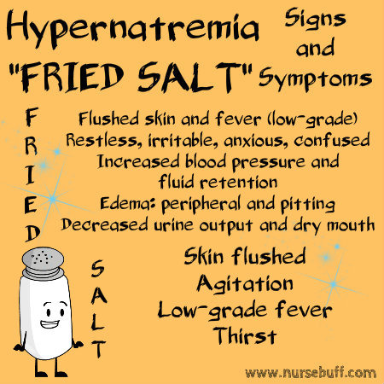
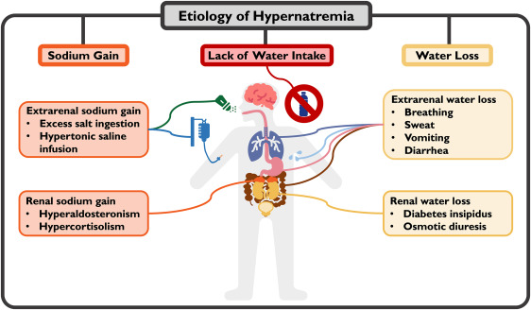

Slide 46
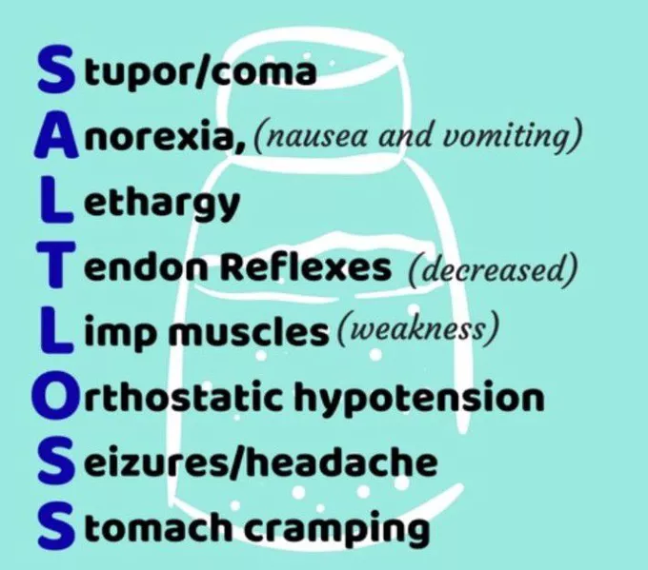
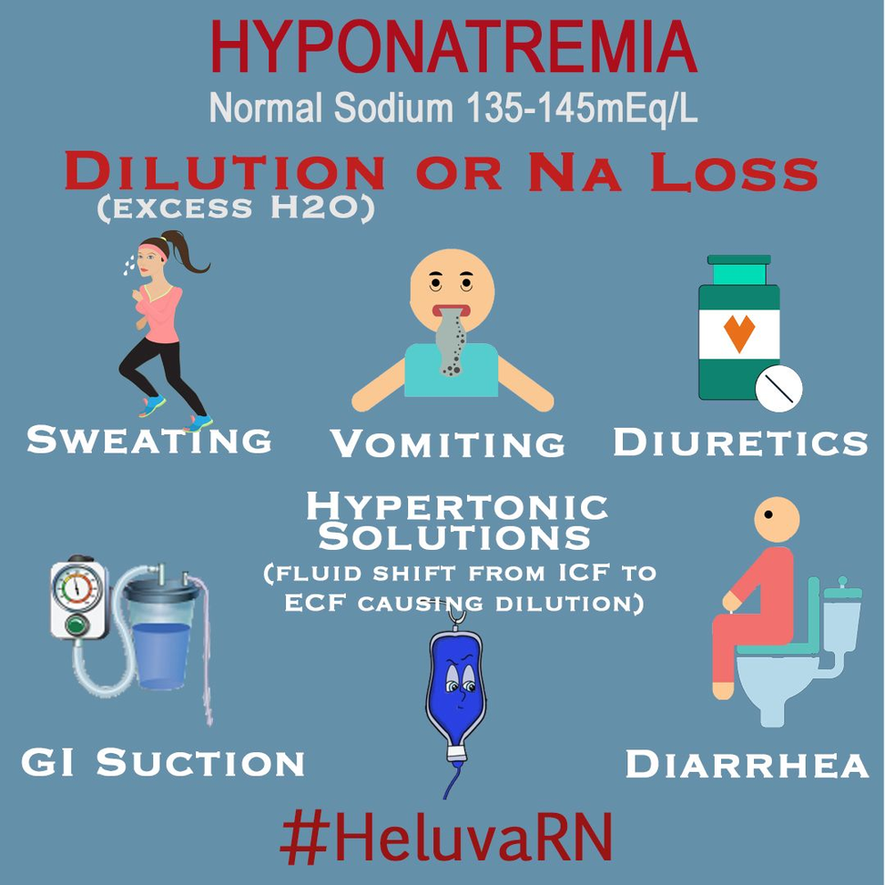

Slide 47
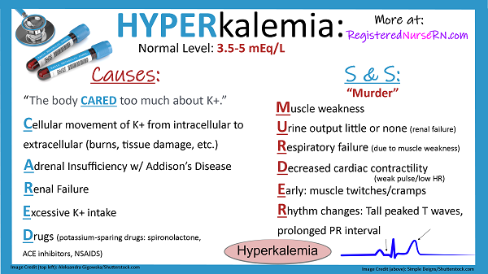

Slide 48
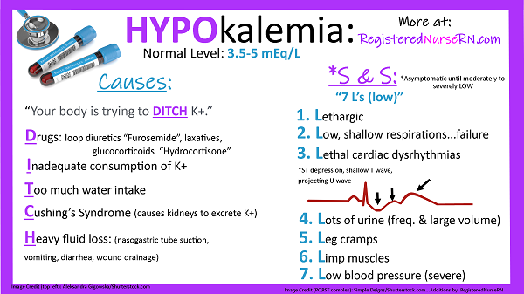

Slide 49
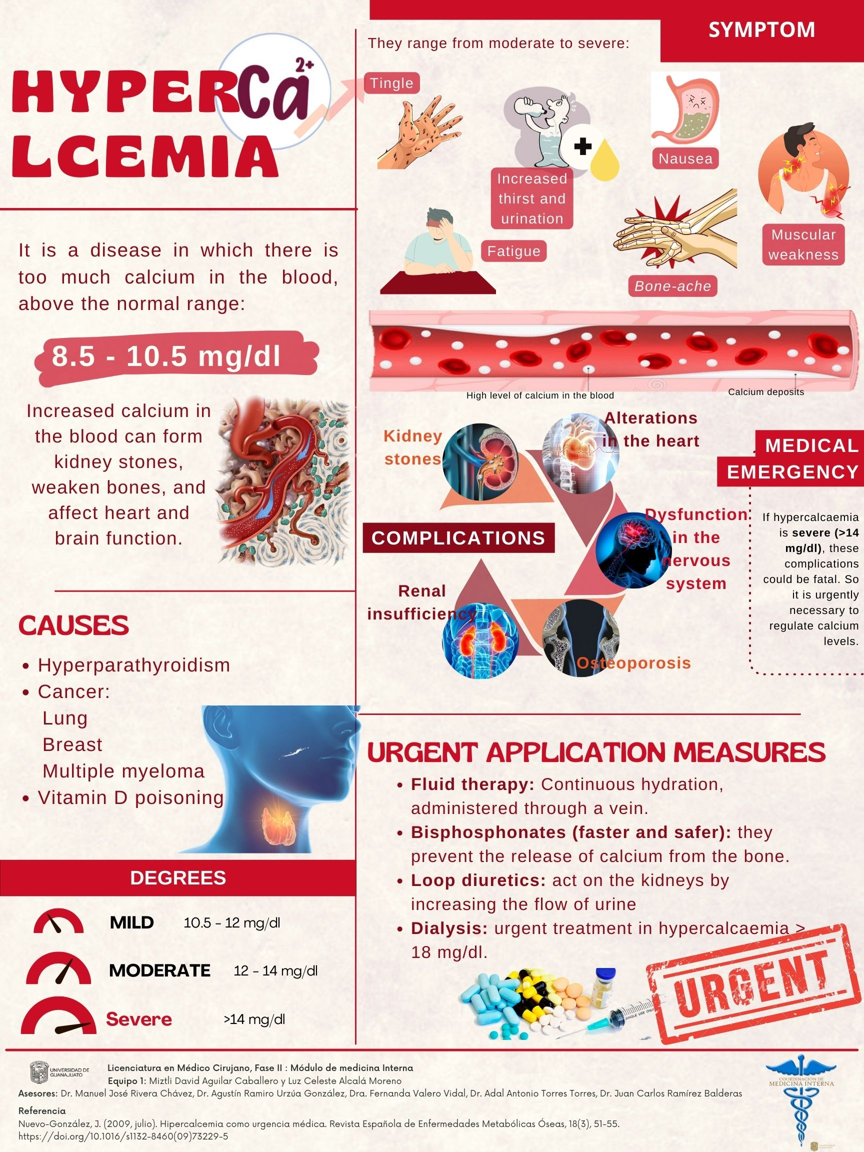

Slide 50
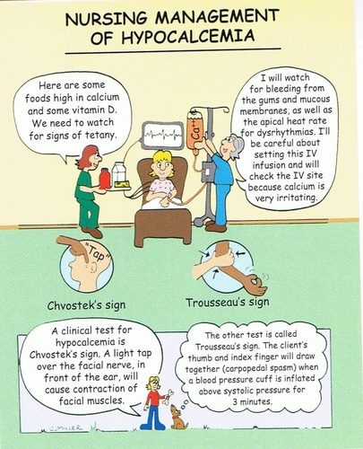
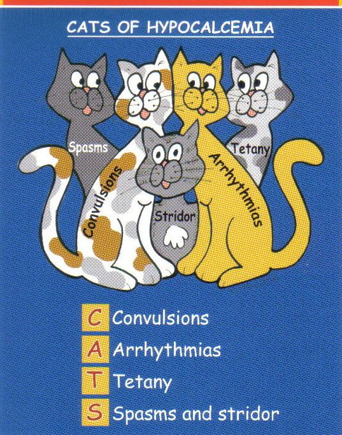

Slide 51
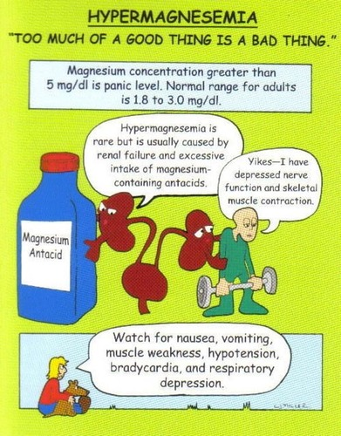

Slide 52
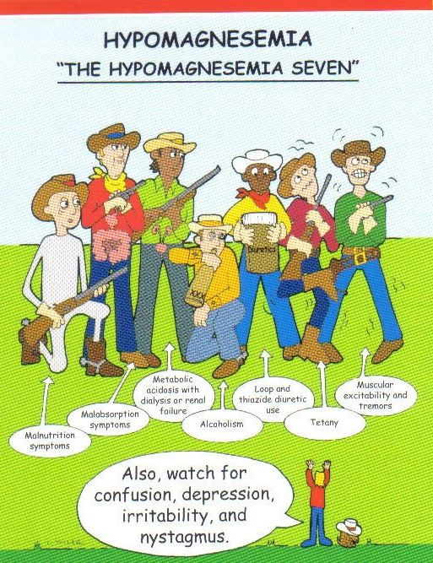

Slide 53
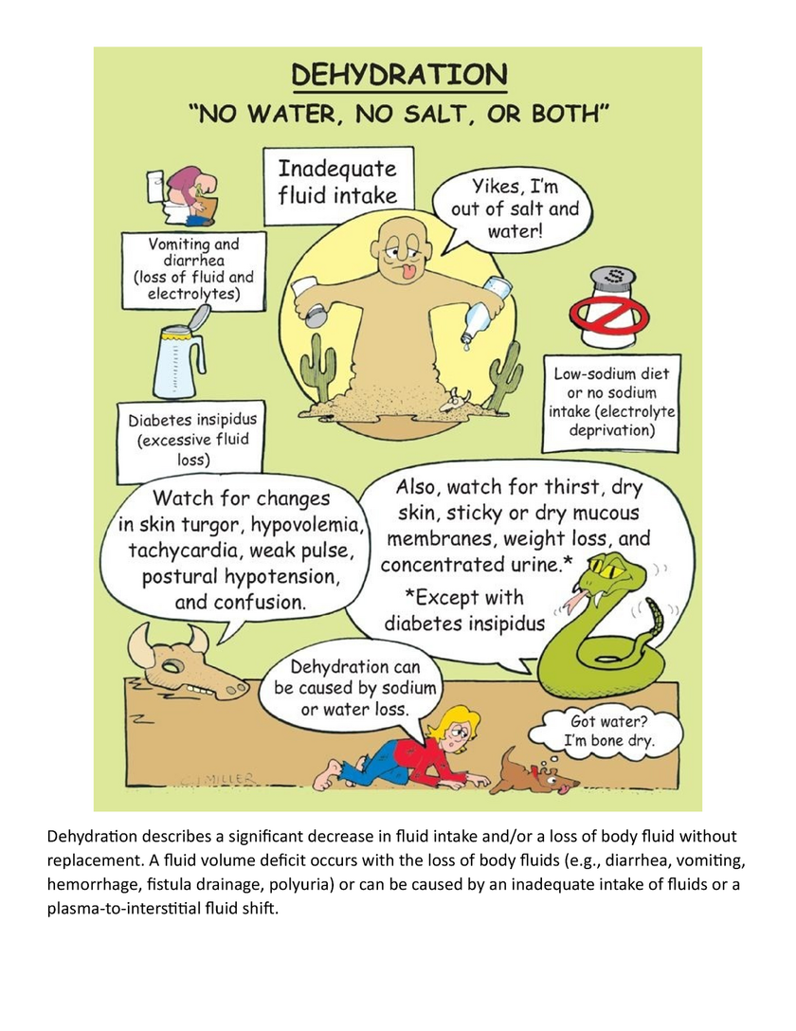
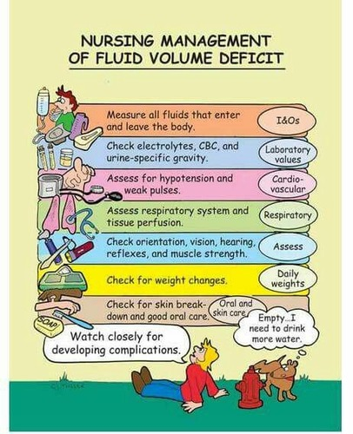
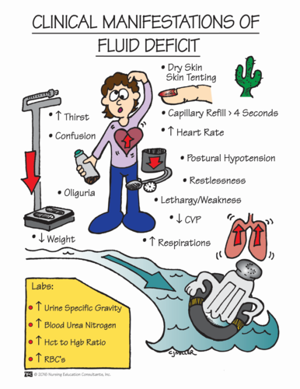
Fluid Volume Deficit
Notes:
Causes: hypovolemia, dehydration, abnormal fluid losses (bleeding, N/V, severe burns)
S&S: ↓urine output, ↑ urine specific gravity, ↑HR, ↓BP, weak or thready pulse, poor turgor, ↑Hgb and Hct, ↑ BUN, dry skin and mucous membranes
Tx: treat the cause
Fluid volume deficit- also called hypovolemia or Extracellular fluid volume deficit
Can also be caused by diuretics

Slide 54


